Slide 1
Contextual Artificial Intelligence Assistant Project CAIA
Benito Alvares

Slide 2
Goals
Study the implementation and working of a contextual chatbot.
Leverage the context of data from a conversational turn in order to improve user engagement with a chatbot.
Evaluate them in specific domains like CTA bus timings, weather information and small talk like chit-chat.
See how the chatbot performs with respect to established assistants like Google or Cortana.

Slide 3
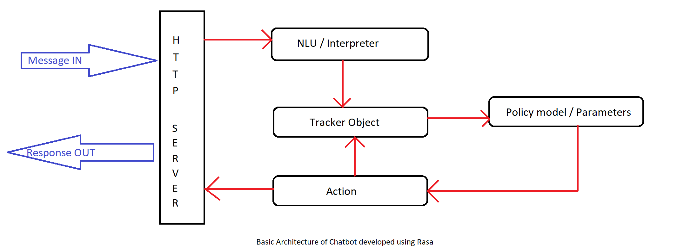
Rasa Infrastructure (Core/NLU)
Github : benza613/Project-CAIA

Slide 4
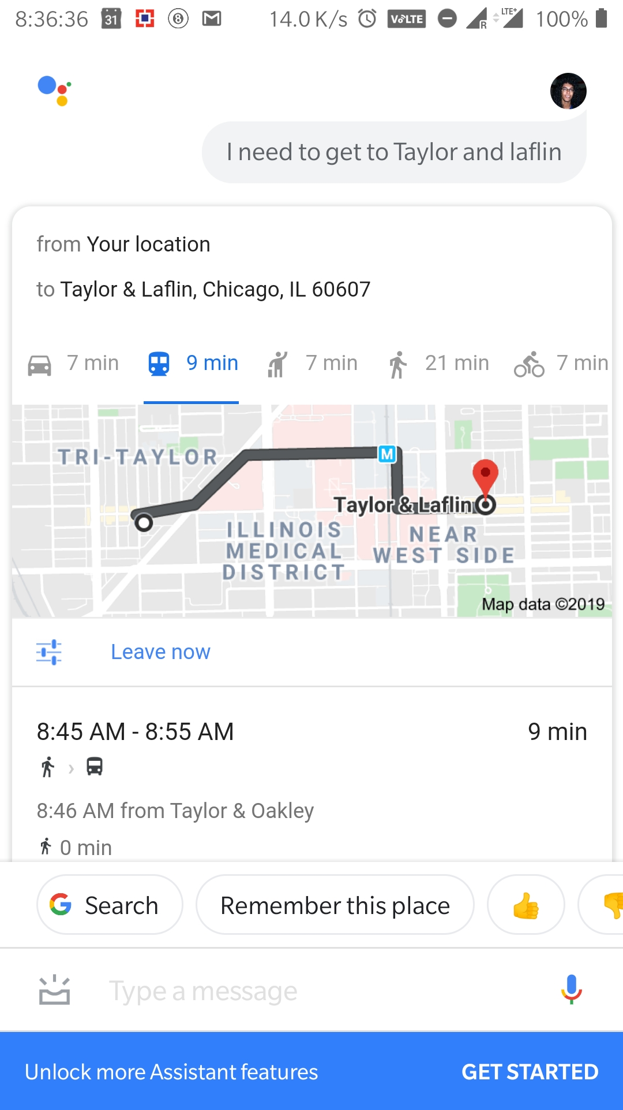
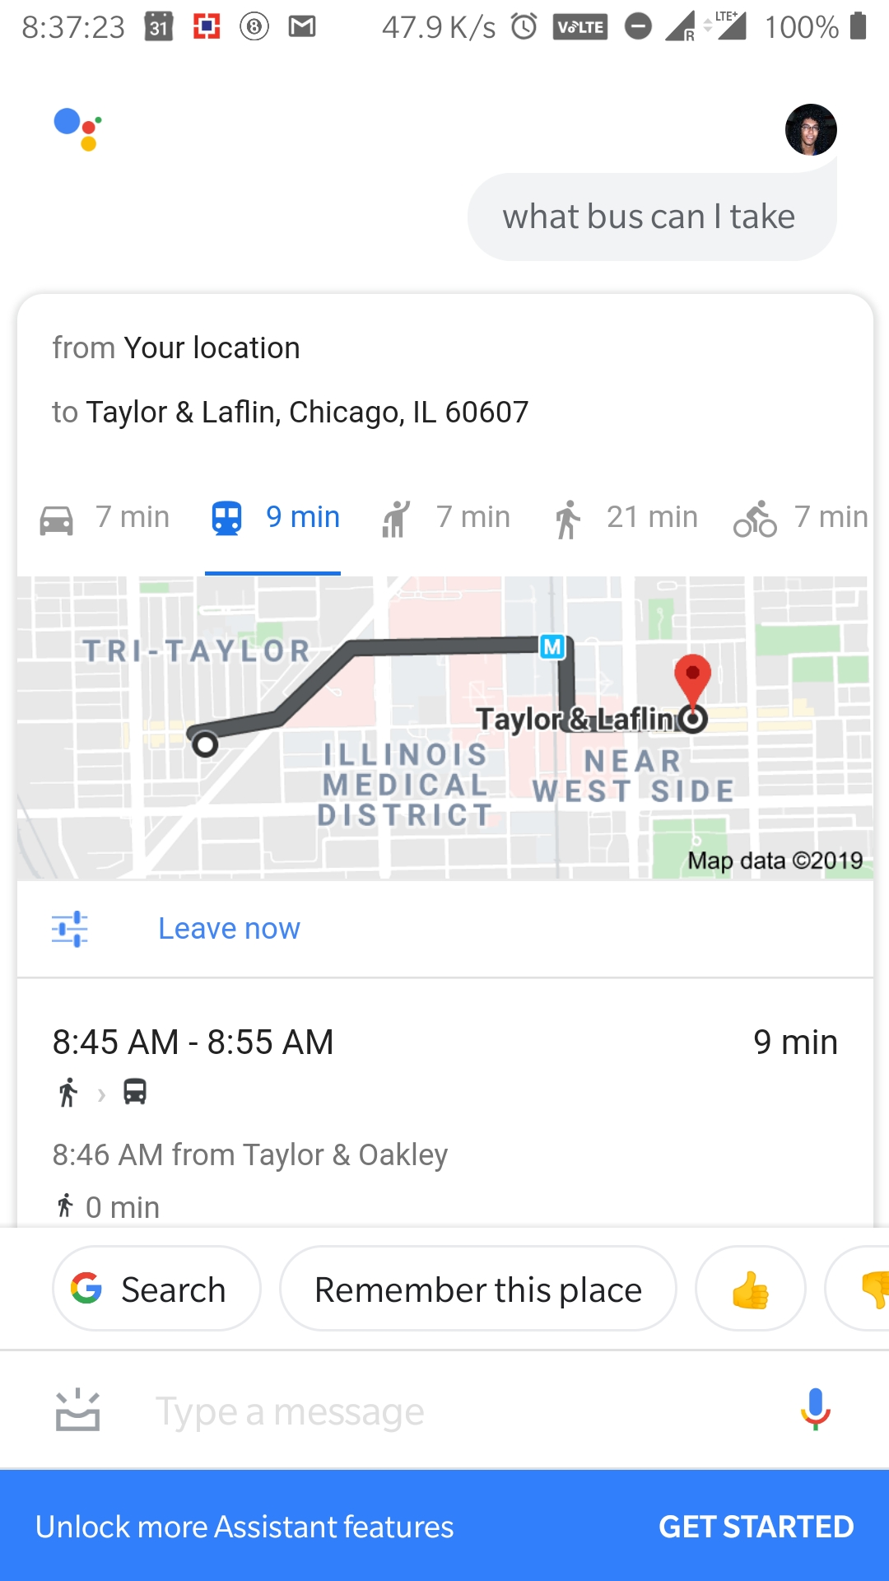
Experiment

Slide 5
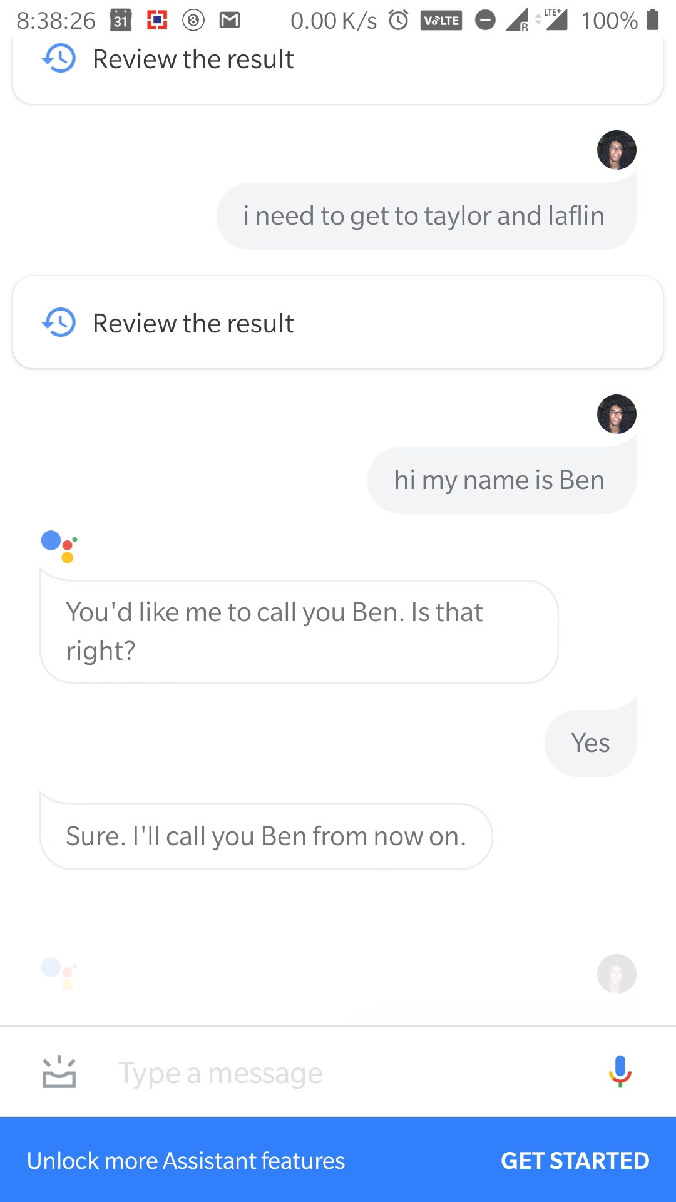
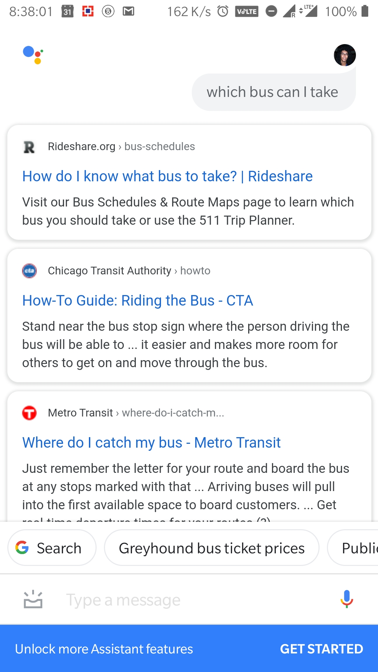
Experiment

Slide 6
Evaluation & Results
Comprehension capabilities
User engagement
Speed
Scalability
Future work to improve these results

Slide 7
Conclusion
implemented a contextual chatbot that is capable of conversing in the domains of CTA bus transport, weather and small talk like chitchat
trained to handle general order conversation in these topics (in English)
respond with meaningful & real-time(or mocked) response to enrich user query and maintain user engagement.

